Slide 1
Mislead Physical-Disruption Attacks by Preemptive Anti-Reconnaissance for Power Grids Cyber-Physical Infrastructures
Hui Lin
Center of Cyber-Physical Intelligence and Security (CYPHER)
Electrical, Computer, and Biomedical Engineering Department
University of Rhode Island

Slide 2
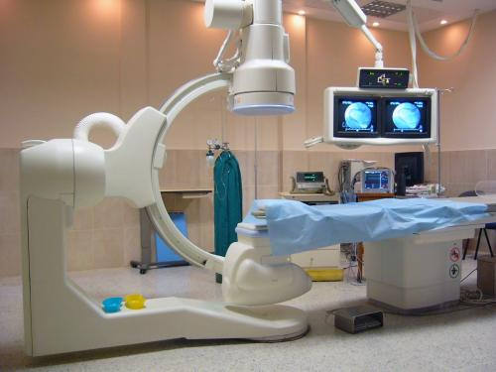

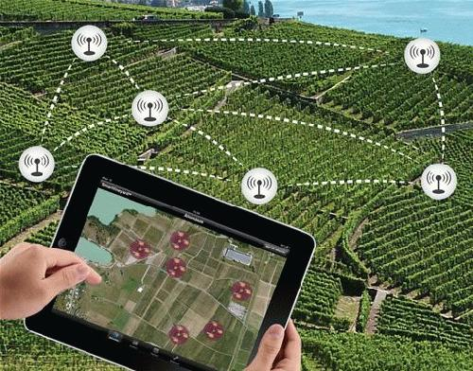
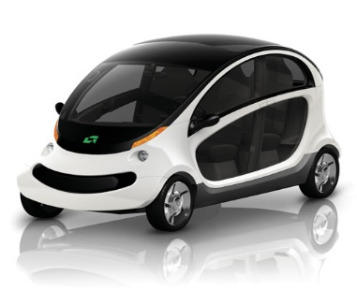
What are Cyber-Physical Systems
Medical Device
Power Grid
Control
Agriculture
Automobile
Compromise
Data
Sensor
Control
Network
Actuator
Compromise
Commands
Physical Process

Slide 3

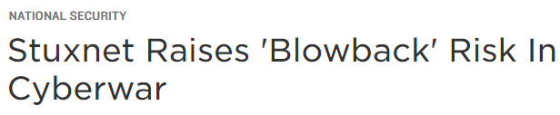




Slide 4

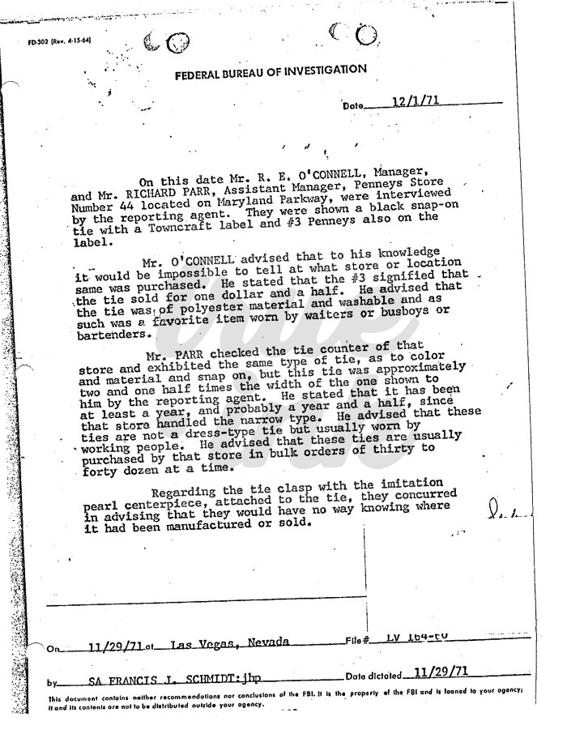




“The attackers demonstrated a variety of capabilities, …, to gain a foothold into the Information Technology (IT) networks of the electricity companies.”
CB 04 0C 28 32 00 F8 07 C5 AC DD
CB 04 0C 28 46 00 D3 07 C5 BA DD
“… the strongest capability of the attackers … in their capability to perform long‐term reconnaissance operations required to learn the environment …”
“The outages were caused by the use of the control systems ...”
“… enabling the remote opening of breakers in a number of substations”

Slide 5
PARP: Mislead Physical-Disruption Attacks by Preemptive Anti-Reconnaissance for Power Grids’ Cyber-Physical Infrastructures
Challenge:
Adversaries perform in-depth reconnaissance, leading to irreversible damage
How to mislead stealthy reconnaissance relying
on legitimate operations
How to craft misleading physical data
Solution:
PARP, the first Preemptive Anti-Reconnaissance that will mislead adversaries about Power grids’ cyber-physical infrastructures
Technical approaches:
  Control Function Virtualization (CFV), neutralizing communication pattern that can pinpoint physical device
  Electrical-Model-Guided Adversarial Generative Networks (EleGAN), crafting decoy physical data conforming to power grids’ physical models
Scientific Impact:
Adversaries perform in-depth reconnaissance, leading to irreversible damage
How to mislead stealthy reconnaissance relying on legitimate operations
How to craft misleading physical data

Slide 6
Enabling Programmable In-Network Security for an Attack-Resilient Smart Grid
Challenge:
The underneath network infrastructure used by existing power grids significantly limits the performance of the existing security solutions
Solution:
Create and quantify programmable in-network security measures for an attack-resilient power grid based on Programming Protocol-independent Packet Processors (P4) architecture
  Customizing real-time in-network intrusion detection system in P4 programmable network switches
  Creating network fault and vulnerability auto correction based on P4’s traffic engineering hardware
  Creating in-network traffic scheduler to disrupt attack reconnaissance by leveraging P4’s hardware units
Scientific Impact:
Advancing existing security solution with existing high-performance network devices
Retrofitting power system application to programmable network infrastructure
Creating next-generation high-performance security solution

Slide 7
CYPHER Mission
URI CYPHER Center (Center of Cyber-Physical Intelligence and Security), established in summer 2020, is committed to advance fundamental research, technology advancement and transfer, as well as workforce and education development in broad domains of cyber-physical security and trustworthy artificial intelligence (AI).
The Center currently has 12 faculty members, whose research addresses security challenges and AI advancement in power grid, computer networks, robotics, integrated circuits, high-performance computers and data centers.

Slide 8
Organization
Director: Yan (Lindsay) Sun, Computer Engineering, IEEE Fellow, NSF CAREER Awardee
Co-Director: Haibo He, Electrical Engineering, IEEE Fellow, NSF CAREER Awardee
Technical Director: Tao Wei, Electrical Engineering, ONR YIP Awardee
Participating Faculty Members (alphabetically by last name)
Kaushallya (Kay) Adhikari: Signal Processing, Information Theory
Yeonho Jeong: Power Electronics
Weiwei Jia: Operating Systems, Systems Virtualization, Modern Clouds
Hui Lin: Cyber-Physical System, System/Network Security
Resit Sendag: High-performance Computing, hardware acceleration;
Manbir Sodhi: Optimization, Industrial Automation;
Paolo Stegagno: Intelligence Robotics, Multi-agent Systems;
Qing Yang: Computer Architecture; software-hardware co-design;
Chengzhi Yuan: Adaptive Control, Robotics

Slide 9
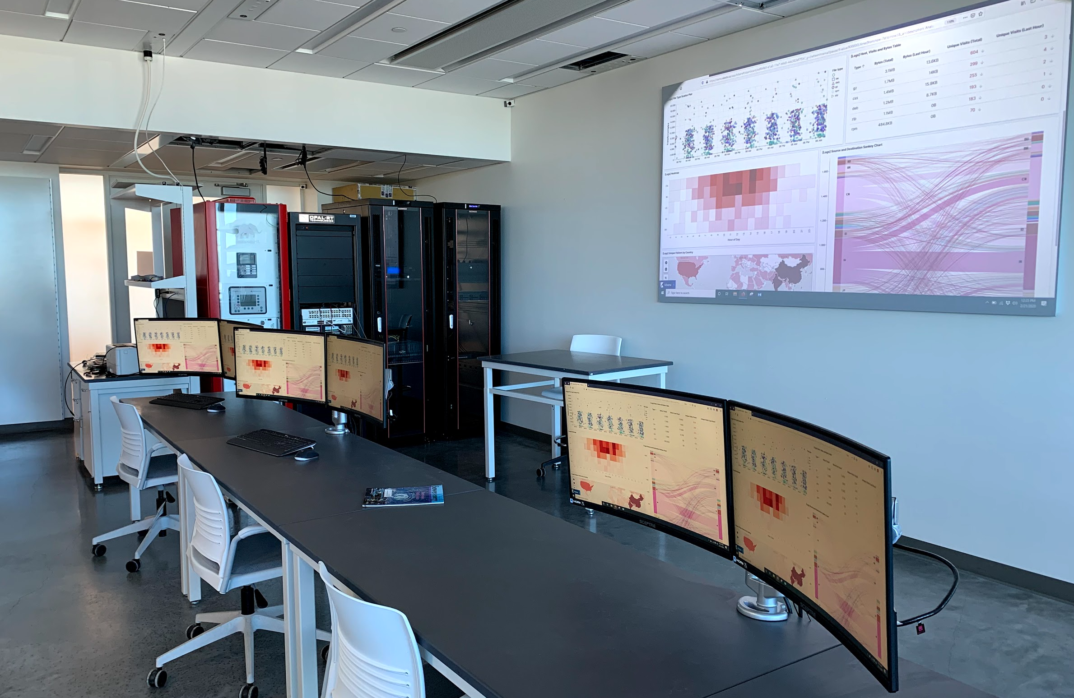
Facilities
CYPHER center, located in newly-established The Fascitelli Center for Advanced Engineering, has a lab space of more than 1,200 square feet, including advanced lab equipment:
  OPAL-rt Real-Time Digital Simulator OP5700
  Typhoon HIL602+ Ultra-High Fidelity Simulator
  Intelligent Electronic Devices from Schweitzer Engineering Laboratories, Allen Bradley, and Schneider Electric
  Programmable network devices and controllers

