Slide 1
Mechanical, Industrial & Systems Engineering
Technology Showcase
Microfluidics and microsystems for environmental monitoring and human health
Yang Lin, Ph.D. /Assistant Professor
College of Engineering
University of Rhode Island
04/18/2023

Slide 2
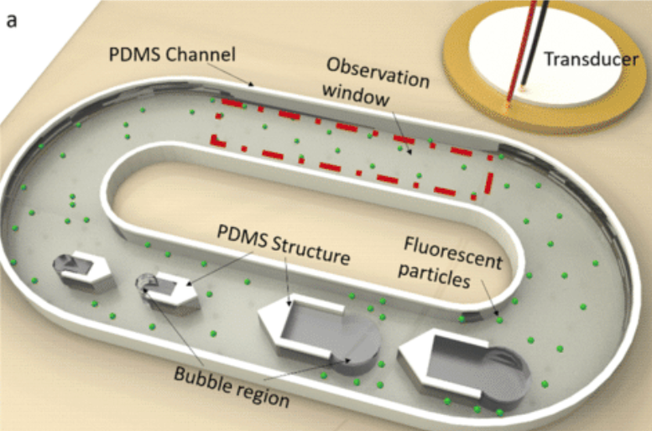
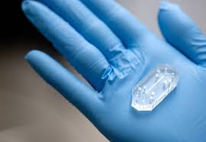
Who am I?
Yang Lin
Assistant Professor, URI
(2020 to Present)
Postdoctoral research associate at UIC
(January 2020 – August 2020)
Ph.D. (2019) in Mechanical Engineering
University of Illinois at Chicago (UIC)
M.S. (2015) in Mechatronic Engineering
B.S. (2012) in Mechanical Engineering
China
Research Interests
Microfluidics and Lab-on-a-Chip
Acoustofluidics
Biosensors
Environmental monitoring
Point-of-care
Microfabrication

Slide 3
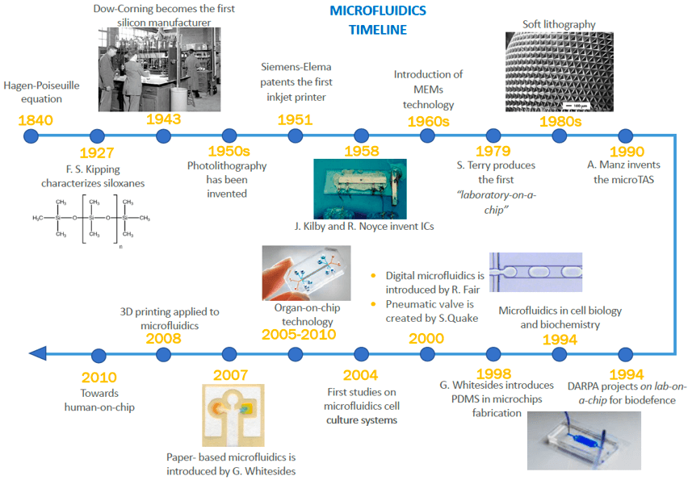

Slide 4
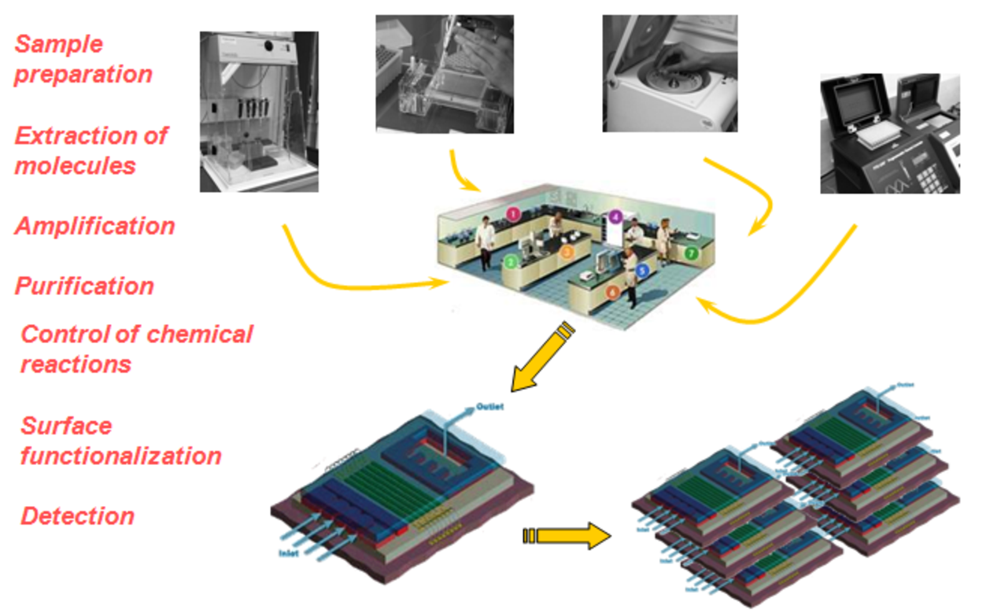
Advantages of Microfluidics
Low sample and reagent consumption; fluid volumes (μl; nl; pl; fl)
Fast analysis, efficient detection
Portable and compact devices
Integration of various functional units – making a “Lab on a Chip” device

Slide 5
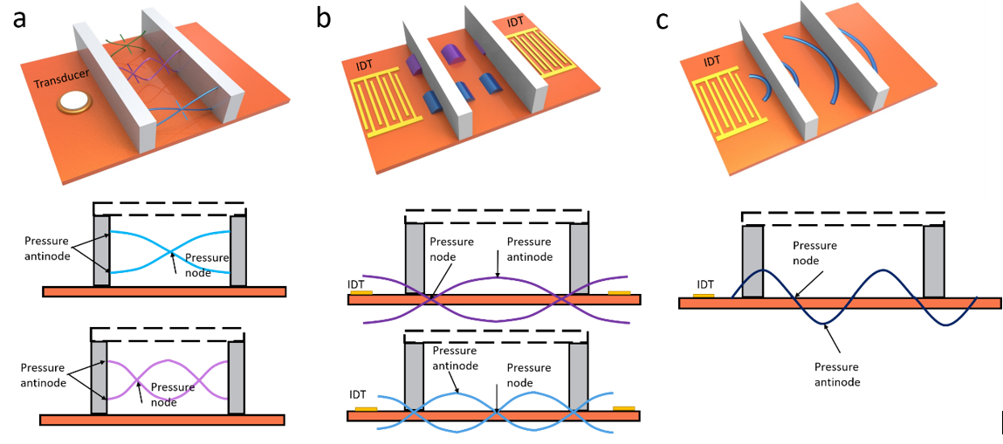
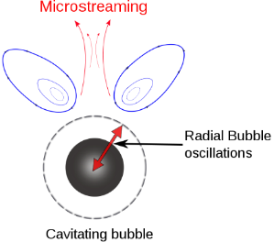
Acoustic particle and flow manipulation
Bulk acoustic waves
Standing SAW
Travelling SAW
Acoustic secondary radiation force
$$F_{SRF}=4πρ_{l}\frac{ρ_{l}−ρ_{p}}{ρ_{l}+2ρ_{p}}\frac{{R_{b}}^{4}R_{p}^{3}}{d^{5}}ω^{2}ξ^{2}$$

Slide 6
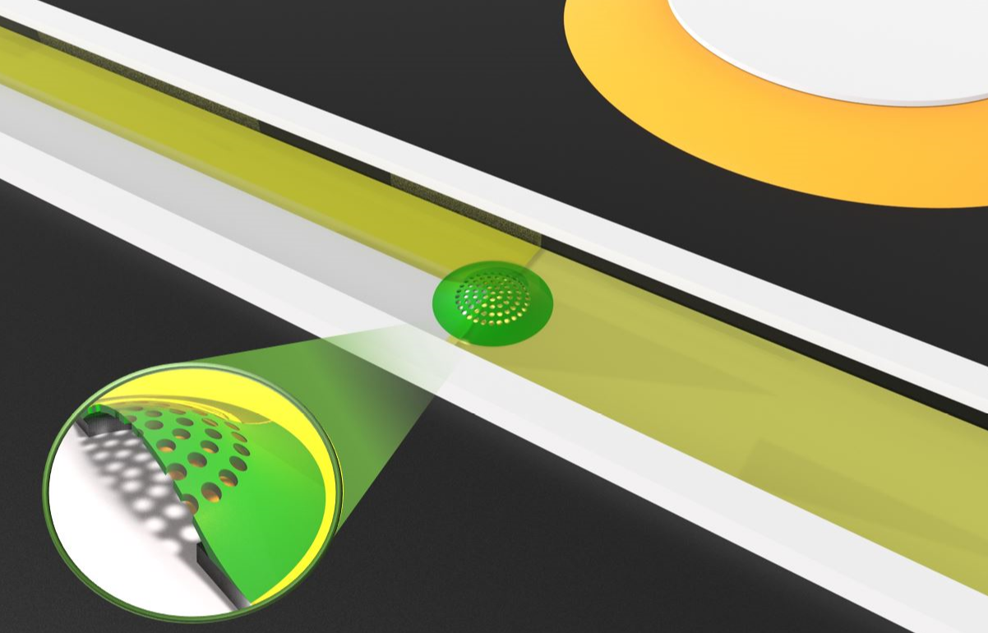
Micromixer on flexible foil
Piezo
Foil
DOMES
Mixed fluid
Through hole
Defended Oscillating Membrane Equipped Structures (DOMES)

Slide 7
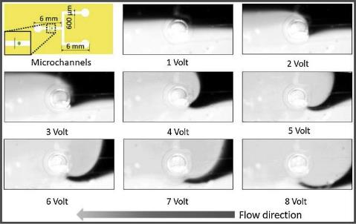
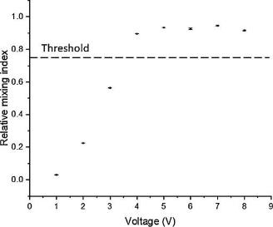

Mixing performance
The intensity of the microstreaming grew with the driving voltage.
Mixing performance increased along with increase of driving voltage.
Relative mixing index (RMI) was calculated at a measuring line after mixing.
$$RMI=1−\frac{\sqrt{\frac{1}{N}\sum_{i=1}^{N}{{\left(I_{i}−〈I〉\right)}^{2}}}}{\sqrt{\frac{1}{N}\sum_{i=1}^{N}{{\left(I_{oi}−〈I_{o}〉\right)}^{2}}}}$$
RMI increased with increase of driving voltage.

Slide 8
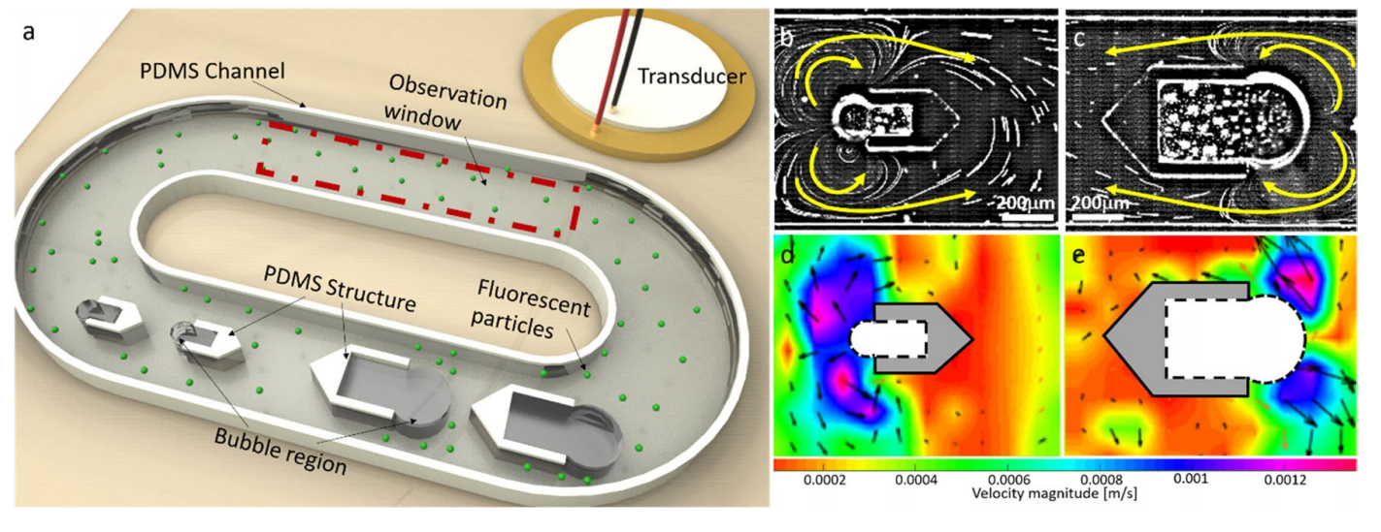

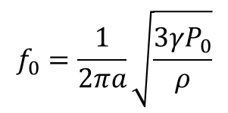





Bidirectional micropump
24 kHz
19 kHz
The strongest microstreaming can be produced when the excited frequency is close to the resonant frequency of the bubble, which of a bubble can be estimated by Minnaert eigenfrequency equation:
(Minnaert 1933)
$$f_{0}=\frac{1}{2πa}\sqrt{\frac{3γP_{0}}{ρ}}$$
$f_{0}$: resonant frequency
$γ:$polytropic exponent, 1.4 for air bubble
$a$: radius of the bubble
$P_{0}:$ambient pressure
$$ρ:density of the liquid$$
$$a$$
Resonant frequency

Slide 9
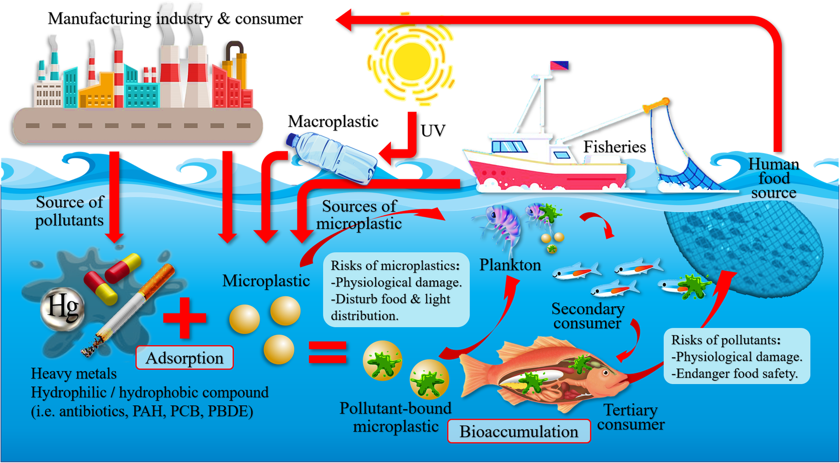
The microplastics cycle
Amelia, T.S.M. et. al. Marine Microplastics as Vectors of Major Ocean Pollutants and Its Hazards to the Marine Ecosystem and Humans. Prog. Earth Planet. Sci. 2021.

Slide 10
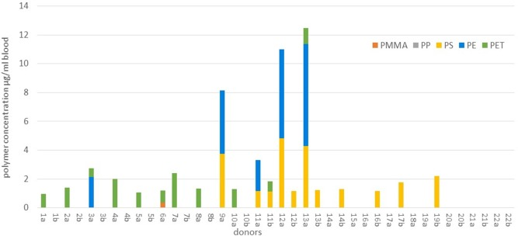
Microplastics in human blood
Leslie, Heather A., et al. "Discovery and quantification of plastic particle pollution in human blood." Environment international 2022.

Slide 11
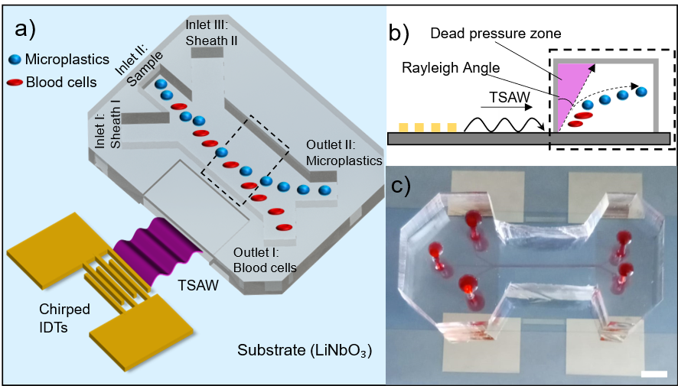
Acoustofluidic separation for microplastics
The microfluidic device used for blood microplastics separation. a) Schematic of the separation mechanism. Once the IDTs are actuated by electrical signals, the TSAW is established on the substrate surface and will displace the particles according to their physical properties (i.e., size, compressibility, etc.). The separation is achieved if the microplastics particles have higher ARF than blood cells with the same operational frequency (larger displacements of microplastic particles). b) Cross-sectional view of the separation process. The TSAW causes a pressure gradient that displaces the microplastics towards the separation region. Due to the Rayleigh angle, there is a dead pressure zone that traps particles and hinders their separation. This region is avoided with the use of Sheath flow I. c) Photo of the actual device. Scale bar is 5 mm.

Slide 12
Mathematical Modelling
Y_{P} = Acoustic Radiation Factor
a = Particle Radius
E = Mean Acoustic Energy
V = Bessel function (1st kind)
U = Bessel function (2nd kind)
x = Helmholtz number
f = Frequency
c = speed of sound

Slide 13
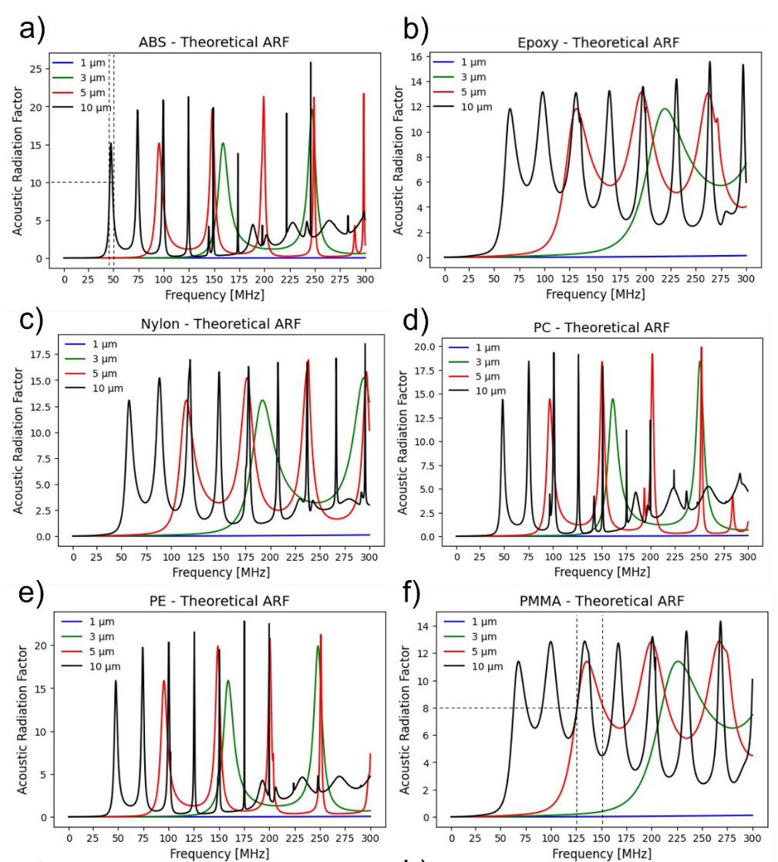
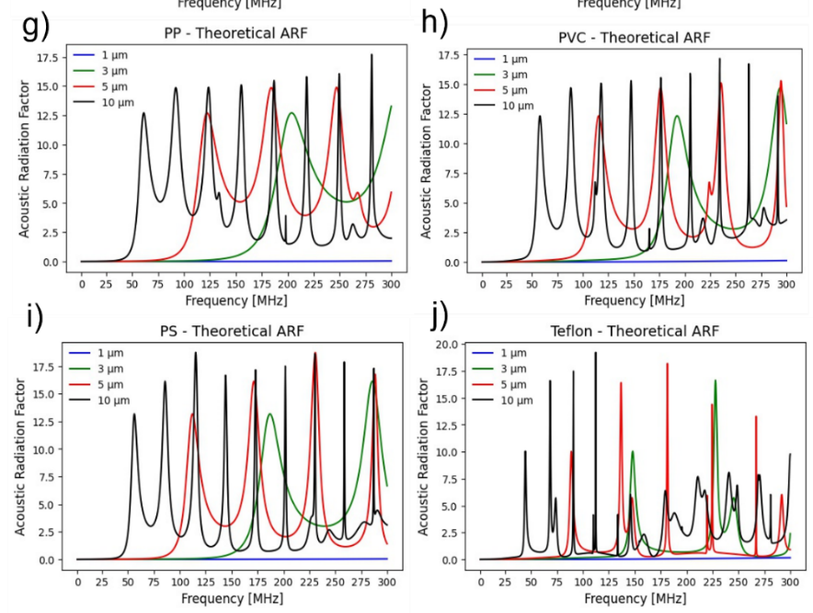
Theoretical Calculation of the Acoustic Radiation Factor
The theoretical ARFs of microplastics of different types and sizes as a function of the input frequency. The results suggested that the minimum frequency required to produce significant ARF increases as the particle size decreases for all types of microplastics studied here. a) ABS. b) Epoxy. c) Nylon. d) PC. e) PE. f) PMMA. g) PP. h) PVC. i) PS. j) Teflon.

Slide 14
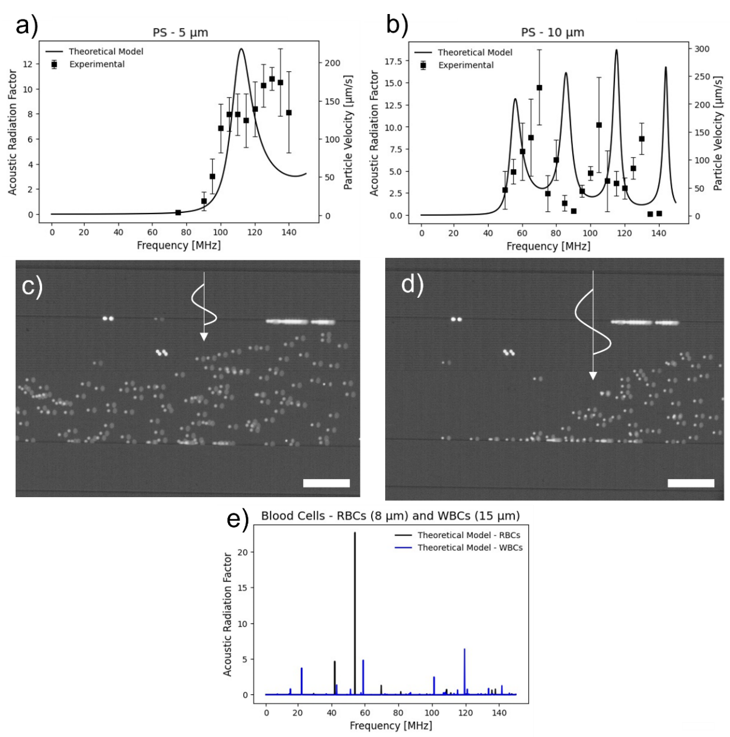
Experimental Validation of the Acoustic Radiation Factor
Comparison between the theoretical prediction of ARF and experimental particle velocity. a) Comparison between theoretical ARF and particle velocity for 5 µm polystyrene particles. b) Comparison between theoretical ARF and particle velocity for 10 µm PS particles. c) Displacement of 5 µm PS particles at 95 MHz. The scale bar is 100 µm. d) Displacement of 5 µm PS particles at 125 MHz. The higher ARF values at 125 MHz induce higher displacements in the particles than 95 MHz. The white arrow indicates the direction of the TSAW. The scale bar is 100 µm. e) Theoretical ARF for red and white blood cells. Blood cells were experimentally tested at resonant frequencies of microplastics such as 125 MHz, no significant displacement was observed.

Slide 15
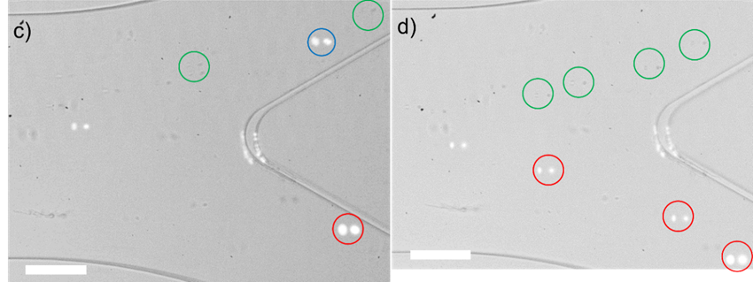
Blood Microplastics Separation using TSAW – Experimental Results
Blood PS separation using 128 MHz, 50% power, and 10 µL/min. Using this operation setup, the separation could not overcome performances of 60%. The image shows a 5 µm PS particle (circled in blue) being deflected towards the wrong outlet, while the 10 µm particle (circled in red) was deflected towards the correct microplastics outlet. The particles circled in green were blood cells. Scale bar is 100 µm. d) Blood PS separation using 128 MHz, 50% power, and 1 µL/min. Reducing the flow rate considerably increased the separation efficiency, achieving values close to 100%. The image shows that both 5 and 10 µm PS particles (circled in red) were displaced towards the microplastic collection outlet. The particles circled in green were blood cells. Supplementary Information contains videos demonstrating the separation process. Scale bar is 100 µm.

Slide 16
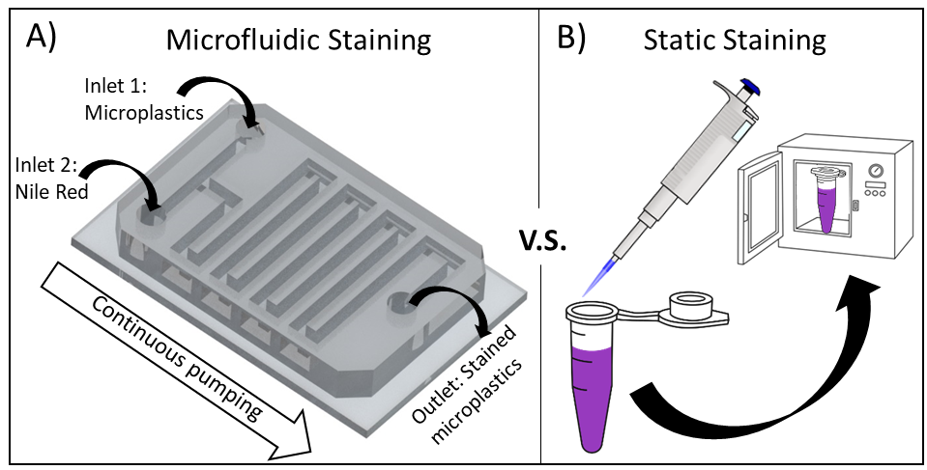
Static and Microfluidic staining
Schematic illustration of the staining processes
A) Process of microfluidics-based continuous staining of microplastics using Nile Red.
B) Process of static staining of microplastics.
Compared to microfluidic staining, the static process is laborious as it requires multiple batches and manual operation.

Slide 17
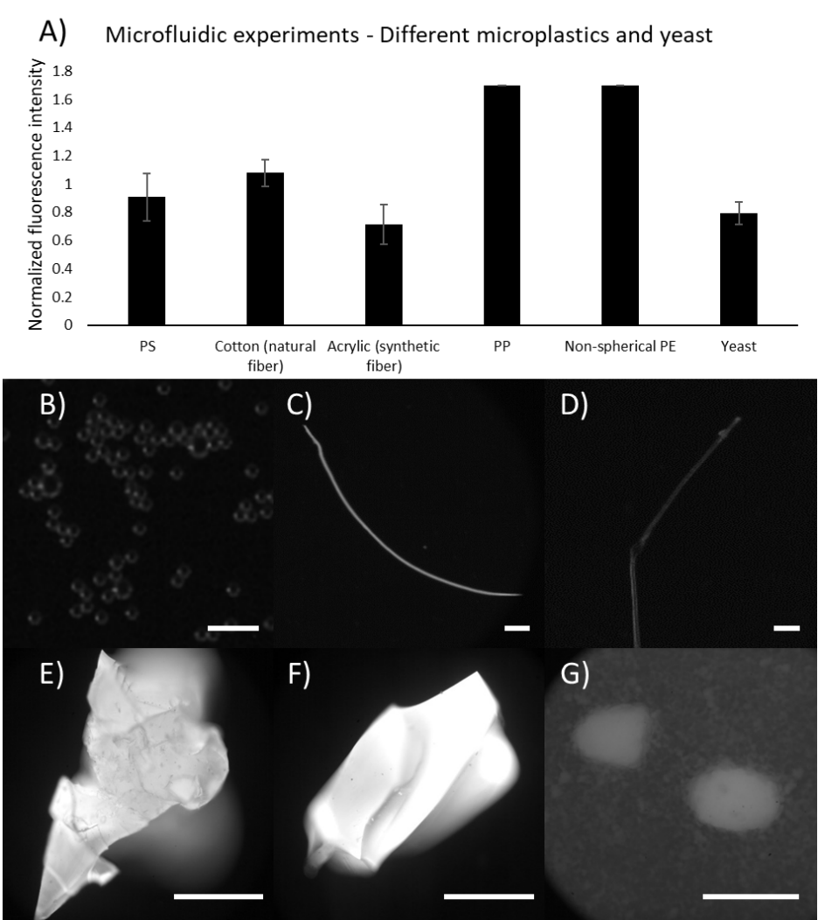
Continuous identification: Microfluidic staining
Microfluidic staining for different plastics and yeast
Fluorescence levels for different microplastics and yeast;
B) PS microspheres; Scale bar is 50 µm;
C) Cotton (natural fiber);
D) Acrylic (synthetic fiber); Scale bars are 1 mm;
E) PP from storage container; Scale bars are 50 µm.
F) PE from storage container; Scale bars are 50 µm.
G) Yeast; Scale bars are 50 µm.

Slide 18
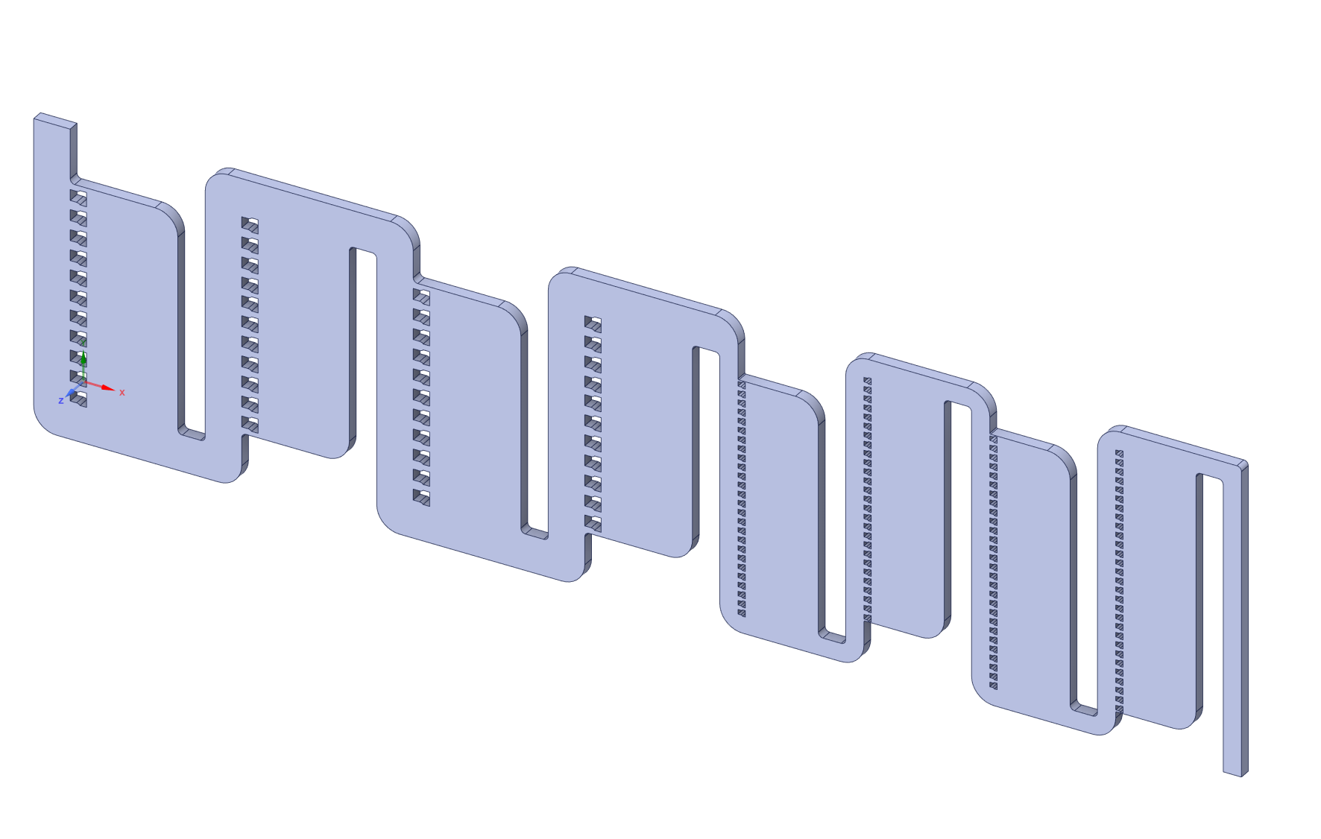
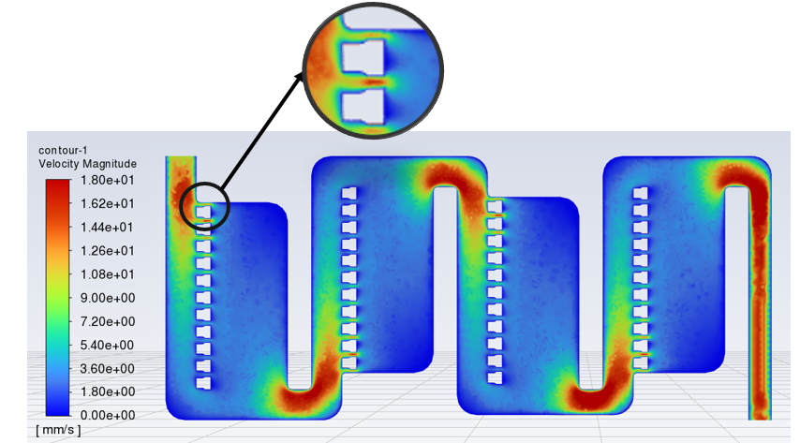
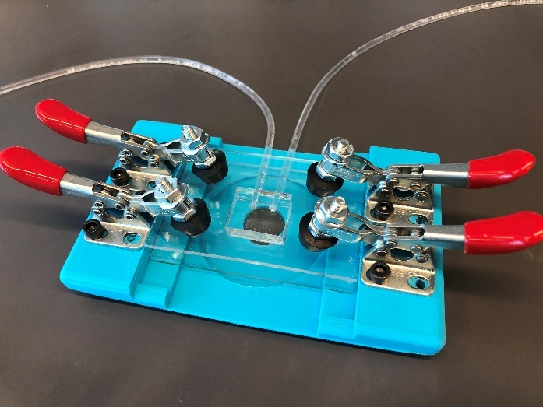
Microfluidic Hydrodynamic Particle Trapping Device
Fluid velocity distribution
Fabrication:
Standard soft lithography
PDMS channel
Full device assembly

Slide 19
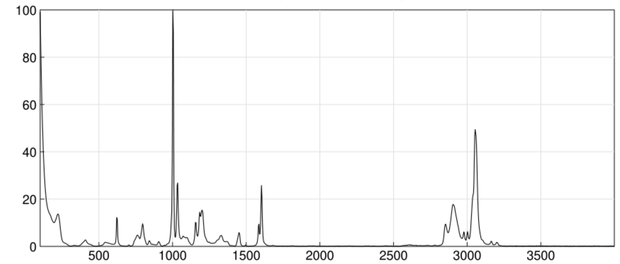
Chemical characterization
Confocal Raman Spectroscopy
Chemical analytical technique used for material characterization.
Advantages:
Capable of identifying particles smaller than 1µm.
Compatibility with liquid sample
Raman Spectrum of Pristine Polystyrene

Slide 20
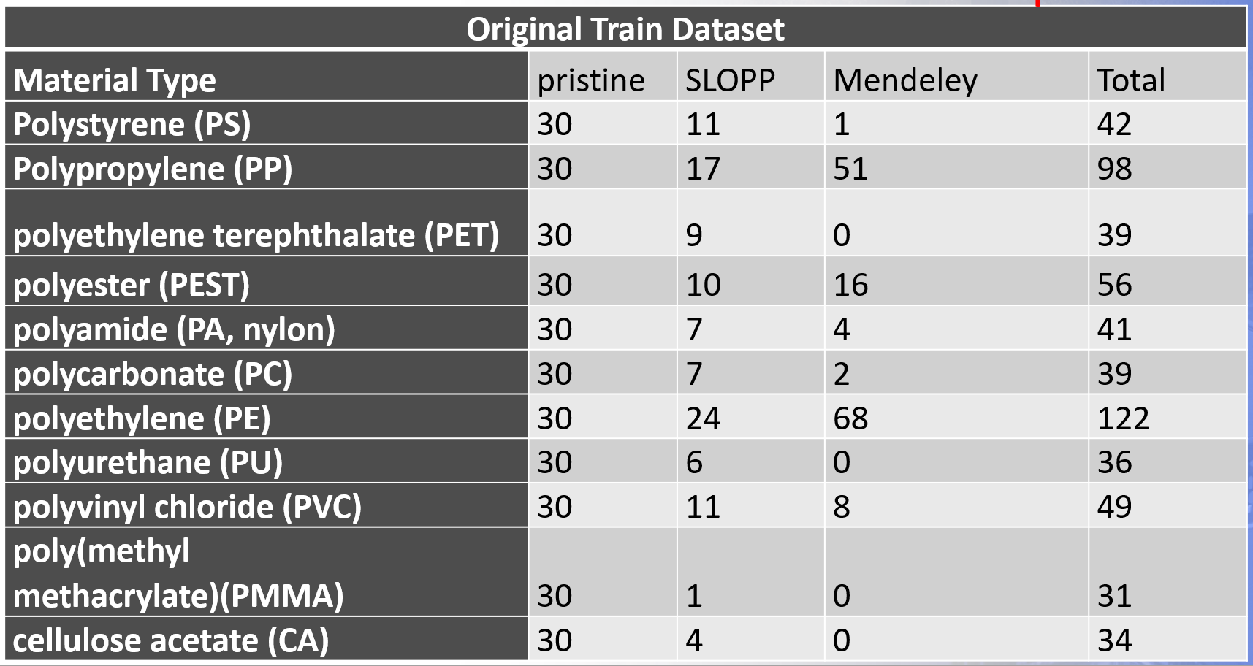
Support Vector Machine (SVM) | Random Forest (RF) | Convolutional Neural Network (CNN) | Residual Neural Network (ResNet)
Easy to train Good accuracy | Work with large datasets | High accuracy | High Robustness

Slide 21
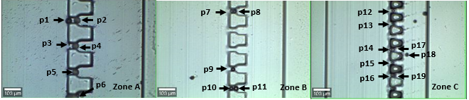
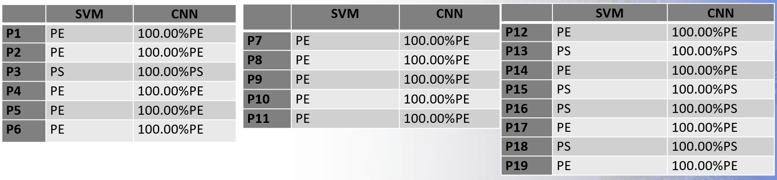
Identification of mixed pristine PE & PS microspheres

Slide 22
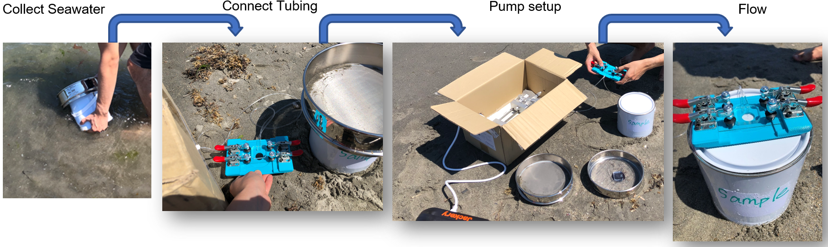
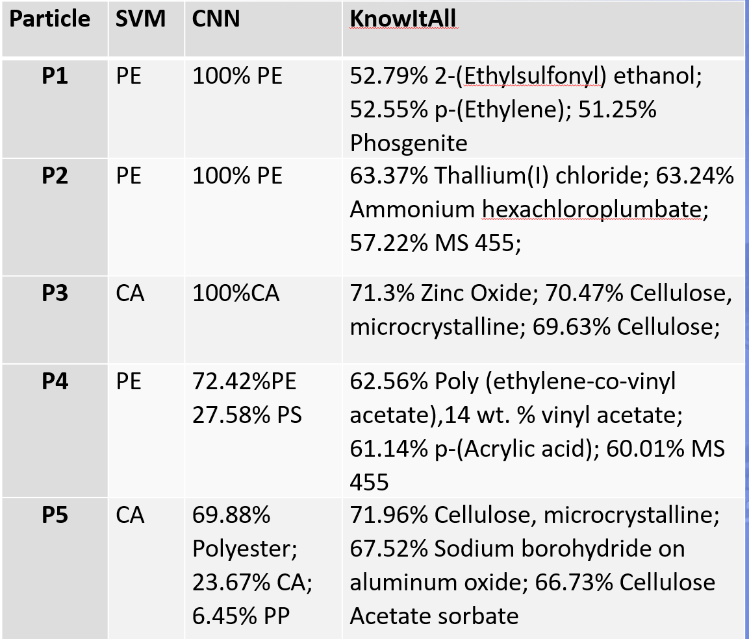
Identification
Results

Slide 23
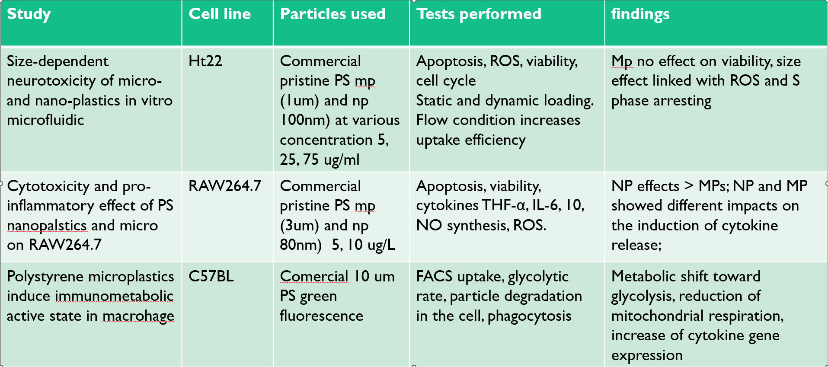
Impact of microplastics on human health
Most on PS

Slide 24
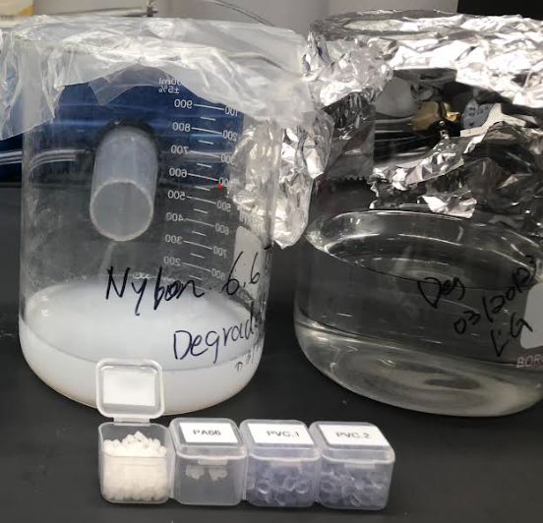
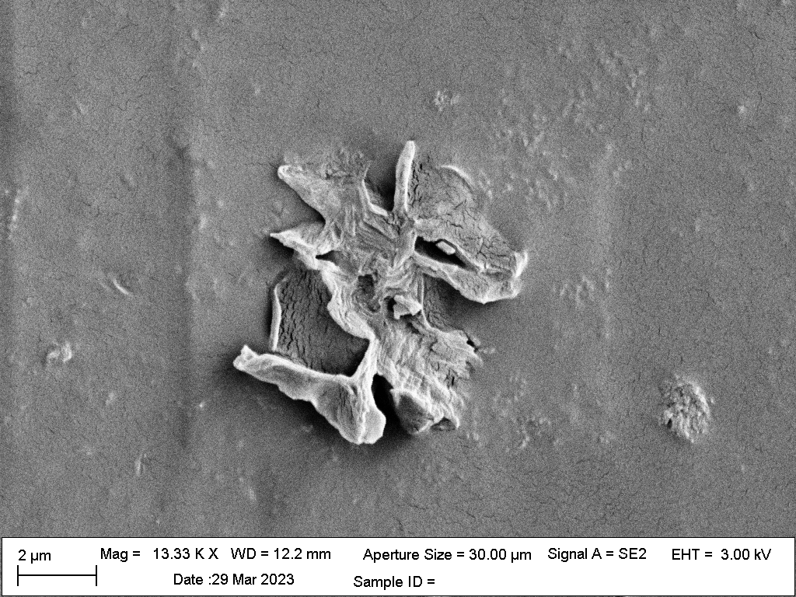
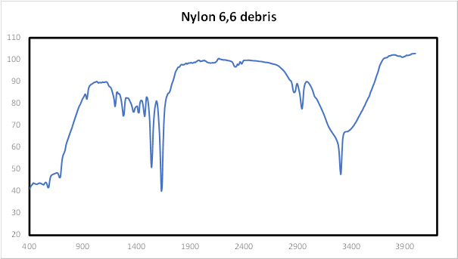
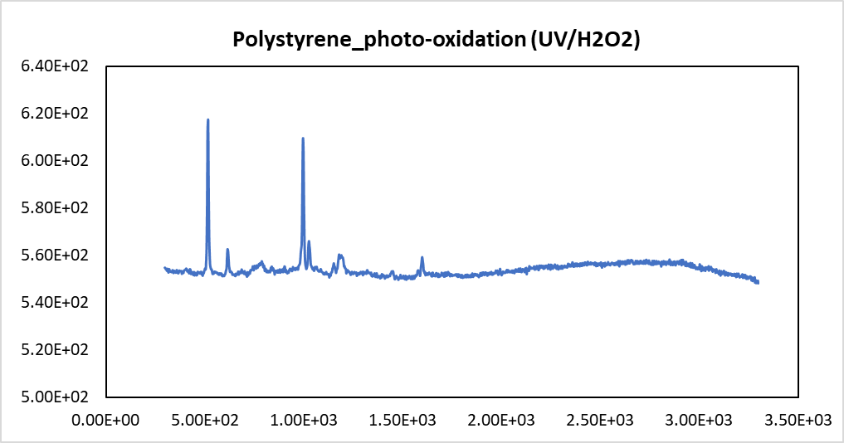
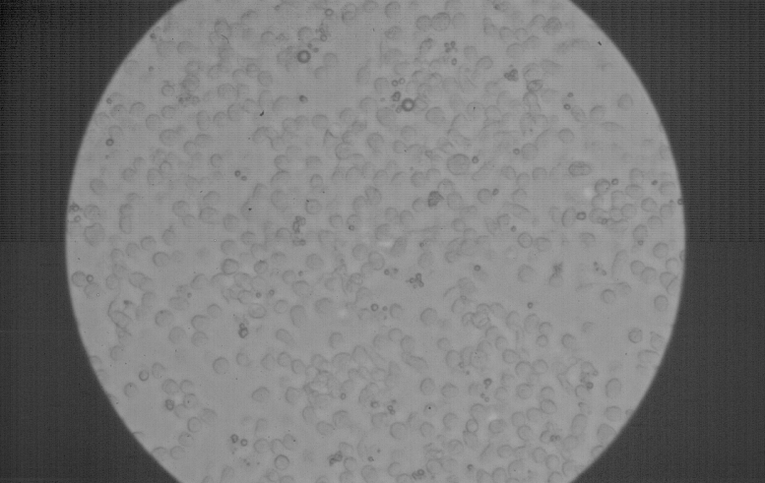
Our method

Slide 25
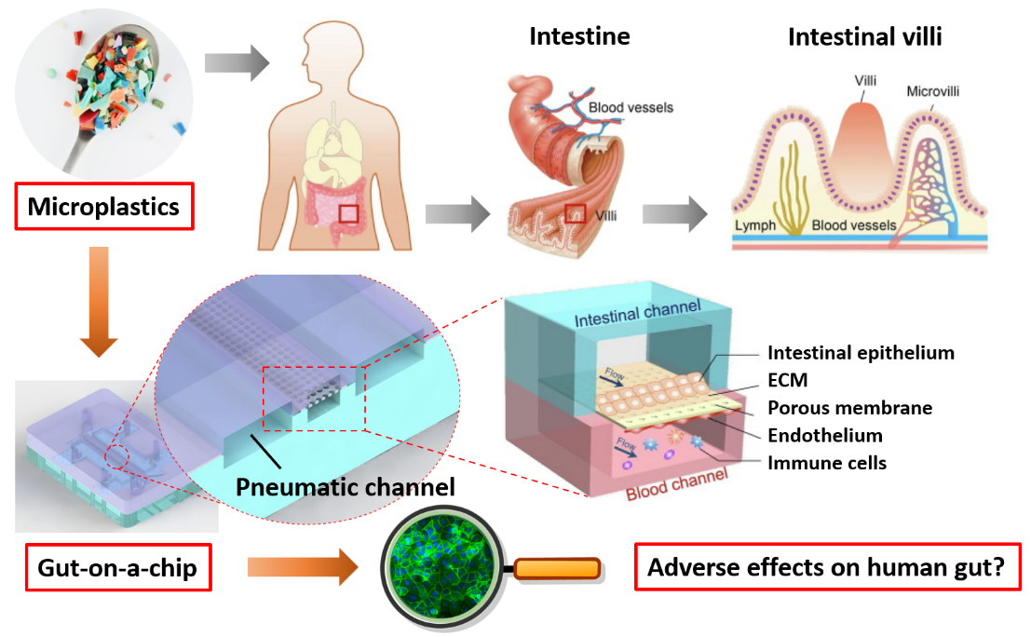
Our method

Slide 26
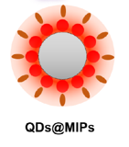
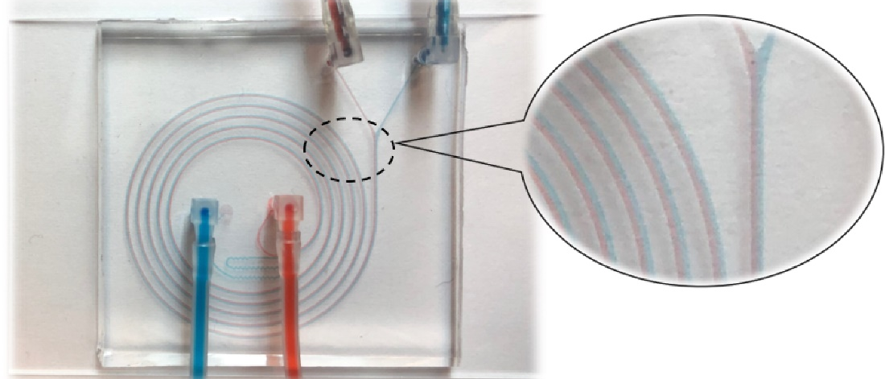
Detection of enrofloxacin in Foods
Quantum dots-based molecular imprinting fluorescence sensor
Notes:
Fluorescence intensity of QDs@MIPs was quenched in the presence of enrofloxacin and showed a linearity in the range of 0.1-50 µg/mL with a limit of detection of 0.059 µg/mL.

Slide 27
Fluorescence quenching amounts of QDs@MIPs after passing through the spiral microchannel. Enrofloxacin standard solutions or enrofloxacin spiked swine muscle sample extractions were injected for MIPs adsorption and fluorescence quenching. (n=5)

Slide 28
Thank You

